Slide 1
2018 SOGRA
ESCAPE
ROOM!
TEAM : RYAN

Slide 2
2018 SOGRA
TEAM : RYAN
INDEX
-
01. TEAM
02.GAME INTRO
03.THEME
04. VIDEO
05. EXPLAIN
06. Q&A
-

Slide 3
2018 SOGRA ESCAPE ROOM
OUR TEAM
OUR TEAM
SANG HOON NAM
JIN WOO JANG
HYUNG JIN JEON

Slide 4

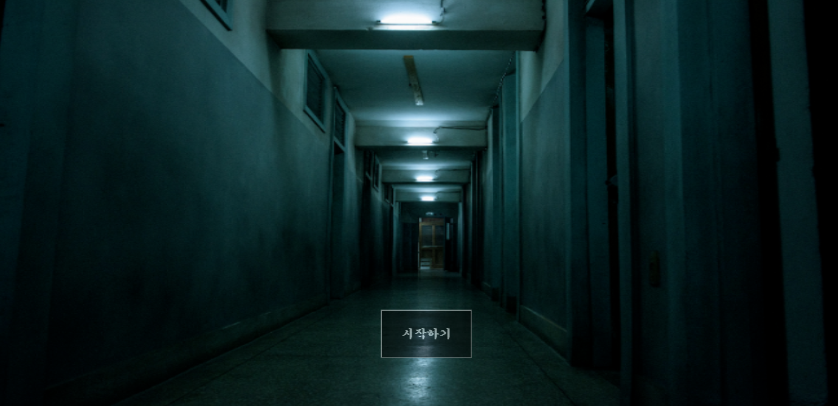
2018 SOGRA ESCAPE ROOM
GAME INTRO
ESCAPE ROOM
A room escape game made using the web.
Development Tool : ATOM
Language : HTML, CSS, JAVASCRIPT

Slide 5

2018 SOGRA ESCAPE ROOM
THEME
INCREASING IQ PLAYING GAME
Room escape game to help increasing IQ

Slide 6

2018 SOGRA ESCAPE ROOM
VIDEO
IN GAME

Slide 7
2018 SOGRA ESCAPE ROOM
EXPLAIN
HOW TO MAKE
..\sogra_source\sogra.html

Slide 8
2018 SOGRA ESCAPE ROOM
Q & A
Q & A

Slide 9
2018 SOGRA ESCAPE ROOM
THANKS!!!!
THANKS !!!
SECOND VERSION WILL BE CONTINUED NEXT YEAR …

